Slide 1
Census Information and training
Get the facts about the 2020 Census!
Melissa Bird, Executive Director
District Census 2020
dccensus2020.dc.gov
#GetCountedDC

Slide 2
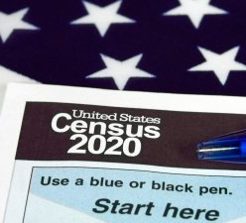
FACTS MATTER
What is the Census?
The US Constitution requires a census every 10 years. The first census was in 1790. The census covers the entire Country and every person living here. The goal is to count every person living in the US, once, and only once, and in the right place.
By law, the US Census Bureau must deliver a report of population counts to the President of the United States within 9 months of “Census Day” (April 1, 2020), so that apportionment can be taken.
The three main ways census data is used at the Federal level:
To reapportion seats in the House of Representatives.
For State officials redraw congressional and legislative districts based on population shifts.
To determine how to allocate more than $675 billion in Federal dollars supporting state and local community programs across the Country.

Slide 4
2020 Census Environment
The 2020 Census is being conducted in a rapidly changing environment, requiring a flexible design that takes advantages of new technologies and data sources while minimizing risk to ensure a high quality population count.
A mobile population
Constrained
fiscal
en
vironment
Informal, complex living arrangements
Rapidly changing use of technology
The 2020
Census
Increasingly diverse population
Information explosion
Declining response rates
Distrust in government

Slide 5
How to Respond to the 2020 Census
An invitation to respond to the US Census will be mailed to every household in DC. This invitation will include a code unique to your address that will lead you to the online survey.
WHAT THE US CENSUS WILL SEND IN THE MAIL TO EACH HOUSEHOLD
March 12-20 | An invitation to respond online to the 2020 Census.
March 16-24 | A reminder letter.
 | IF YOU HAVEN’T RESPONDED YET:
March 26-April 3 | A reminder postcard.
April 8-16 | A reminder letter and paper questionnaire.
April 20-27 | A final reminder postcard before the US Census follows up in person at your residence.
Once you have the invitation you can either respond online, call the US Census to complete over the phone or call and request a hard copy be mailed to you.

Slide 6
Where are people counted?
The US Census bureau seeks to count all people in the United States at their usual place of residence (the HOUSEHOLD) which is the place where they live and sleep most of the time, on or around Census Day April 1, 2020
A household consists of all the people who occupy a housing unit. A house, an apartment or other group of rooms, or a single room, is regarded as a housing unit when it is occupied or intended for occupancy as separate living quarters.
A household includes the related family members and all the unrelated people, if any, such as lodgers, foster children, wards, or employees who share the housing unit. A person living alone in a housing unit, or a group of unrelated people sharing a housing unit such as partners or roomers, is also counted as a household.
Only one person in each household needs to complete the census form but must include all the other adults and children living in the household even if they are unrelated .

Slide 7
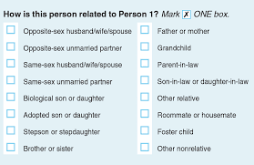
Where are people counted?
What about….?
Children - All children who live in your household, including grandchildren, nieces and nephews, and the children of friends. Children who split their time between households, if they are living with you on April 1, 2020. Newborn babies, even those who are still in the hospital on April 1, 2020.
College Students Off Campus - students who live on campus will be included in the University “Group Quarters” count. Students in off campus housing will need to complete one census form for their household and include any roommates who also reside in the household.
Roommates- one form per household. One person will complete the form and add all roommates onto the census form.
Multiple generations - only one person will need to complete the form but will need to include everyone in household, such as grandparents, grandchildren and parents.
More than one family in one Household - only one person will need to complete the form but will need to include every person (adult, children babies) from other families on the same form who reside in the household.
Informal or complex arrangements - only one person will need to complete the form but must include all additional persons in household even if they are unrelated or expected to not reside permanently in the household. Foster parents must include foster children on their Census forms.

Slide 8
Confidentiality and Privacy of Census Data
The Census Bureau is required by law to keep information confidential. All responses provided on the 2020 Census questionnaire or to a Census Bureau employee are confidential and protected under Title 13 of the U.S. Code
We will never share a respondents personal information with other government agencies
Results from the census are reported in statistical summary format only
Records are confidential for 72 years by law (Title 44, U.S. Code)
All Census Bureau employees swear a lifetime oath to protect respondent information.
Penalty for wrongful disclosure is up to 5 years imprisonment and/or a fine of $250,000
The Census will never ask you for:
Your Social Security number.
Money or donations.
Anything on behalf of a political party.
Your bank or credit card account numbers.

Slide 9
Protecting Household Privacy
Only sworn census takers (full time or contract employees of the US Census Bureau), can complete a census form or receive personal information from a resident. The US Census Bureau will hire hundreds of local contractors to conduct the door to door follow up for households that have not completed a census form by the end of April 2020.
No one, other than US Census employees should go door to door to collect information. Doing so could create confusion for households. Door to door canvassing may elevate concerns about a scam or mistrust of government.
Partners are encouraged to:
Knock on doors to remind people to complete their forms before self response begins.
Provide access to computers.
Provide language assistance.
Answer questions about the census form.
Assist people with logging onto the online form or with calling the census bureau.
Host or attend census information events.
Provide links to the 2020 Census website.
Share information about the census in person or across multimedia platforms to spread awareness about the census.

Slide 10
FIVE FAST FACTS
The census is used to allocate Federal dollars to DC for programs that benefit every community.
Participation in the census is required by law.
In DC, every household will be mailed an invitation to complete their form online or by phone (or to call and request a form be mailed to you).
If a resident does not want a US Census taker to follow up at their door, they must complete the form during the self-response phase.
Your data is confidential and will never be used for any law enforcement purposes at the Federal or local level.

Slide 11
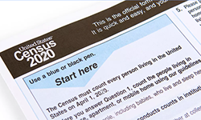
2020 CENSUS QUESTIONS

Slide 12
2020 Census Questions
How many people are living at your home at the time of the Census
Age, race, sex of each person in the household
Whether the home is owned or rented
Whether a person in the household is of Hispanic, Latino or Spanish origin
The relationship of each person in the household to one central person (usually the person completing the form for the household).

Slide 13
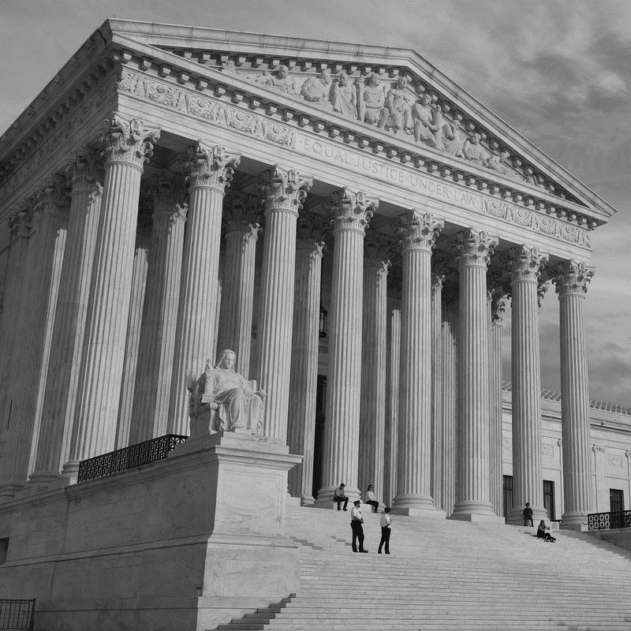
NO CITIZENSHIP QUESTION IN 2020!
“For now, this latest attempt to intimidate our immigrant neighbors is off the table, but the work to end the fear and distrust that the Trump Administration is creating in our immigrant communities continues. With today’s ruling, we can focus our local 2020 Census efforts on getting a fair and accurate count that represents our entire city. And, going forward, we will continue urging the federal government to keep a citizenship question off the Census and keep the focus where it should be – on getting every person in our nation counted and getting our cities and towns the resources they need to build stronger communities.” Mayor Bowser June 27, 2019
June 27, 2019
The US Supreme Court ruled that the Commerce Department’s decision to add a citizenship question to the 2020 census violated federal law.
The case was sent back to the district court for further proceedings which will not be resolved before the 2020 Census.

Slide 14
Language Assistance from the US Census
The online form will be available in 13 written languages upon request (English, Chinese, Korean, Russian, Spanish, Vietnamese, Arabic, French, Haitian Creole, Japanese, Polish, Portuguese, and Tagalog).
1
The paper form will be available in English and bilingual English-Spanish.
2
Census Questionnaire Assistance will be available in English and the same 12 non-English languages referenced above.
3
Telecommunications Device for the Deaf (TDD) assistance will be available.
4
The Census Bureau will provide language guides in 59 non-English languages (see handout)
5

Slide 15
The 2020 Census and DC

Slide 16
Why does the Census matter to DC?
Financial Resources-$3 billion annually to DC through Federal Assistance Programs
Planning and Policy Guidance-population data used by almost every District Agency to set priorities
Social and Racial Equity-the District must continue to ensure that the most vulnerable residents are counted and that District policies continue to support the diversity that makes DC great.
Updating Ward Boundaries-Ensure fair and equal representation across 8 Wards.

Slide 17
DC: Critical Issues in 2020
New Process
Low Response Tracts
Citizenship Question
Vulnerable Populations
Online Privacy
New online response format may lower the response rate for seniors or residents with limited internet access (up to 22%)
1/3 of DC Census tracts are at risk of being “Low Response Rate” (up to 40% of residents are expected not to respond)
Immigrant population increased by 25% since 2010 in DC. Distrust of government in the immigrant community is at an all time high.
An undercount disproportionately impacts low-income African Americans, immigrants, seniors, children under 5.
Concerns about keeping personal information safe, private and for Census use only.

Slide 18
Mayor’s Complete Count Committee
The Mayor’s Complete Count Committee is a partnership of government, private sector and non profit members appointed by the Mayor.
Membership includes both high level District government leaders and influential community leaders who are charged with developing a Census awareness campaign.
Community representation includes:
Higher Education
School Aged Children
Faith Based organizations
Business community
Sports/Entertainment
East of the River neighborhoods
Non-Profit and Philanthropy organizations
Immigrant Advocates

Slide 19
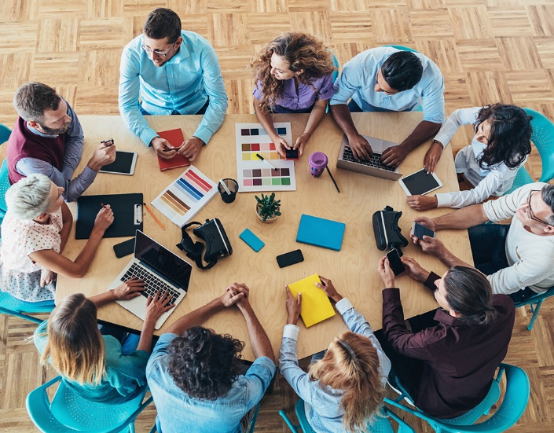
Subcommittees
Subcommittees are formed to target specific hard to count populations or geographies. Additional partners may be added to each subcommittee:
Immigrants
East of the River (Wards 7 and 8)
Faith Based Communities
Seniors
Higher Education
School Aged Children
Media/Communications
Businesses
Each subcommittee will have a chair. The job of the subcommittee is to break down the steps needed to reach their targeted population or geography.

Slide 20
Census Grantees
Anacostia Coordinating Council
Asian American LEAD
Asian Pacific American Film
CARECEN-Central American Resource Center
Casa Ruby
Congress Heights Community Training and Development Corporation
Ethiopian Community Center, Inc.
Greater Washington Urban League
Housing Counseling Services
Latino Economic Development Corporation of Washington DC
Literacy Volunteers and Advocates
Mary's Center for Maternal and Child Care, Inc.
National Housing Trust
Renaissance Center for Culture and Education
Thrive DC
United Planning Organization

Slide 21
Two Key Phases of Work
2019
Education
2020
Motivation
Make sure every resident is aware of the new online format coming in 2020.
Activate the Complete Count Committee
Identify community partners, launch grant program
Develop community partner/District Agency work plans
Host or attend special events, community meetings to talk about the importance of Census
Hold multiple “Census Solutions” training sessions for partners, agencies, and interested residents.
Develop messaging, branding, and media plan
Update all media materials to activate participation
Create informational “how to” videos
Utilize data tools to ensure on the ground resources are deployed in hard to count tracts
Inventory of public computers, or willing partners such as churches or schools
Set up and staff resource centers around the City
Continue online, print and face to face engagement through at least May 2020.

Slide 22
Creating an Engagement Plan
Objective
Who can help?
Resources Required
Review the Community Outreach Toolkit
Trusted messengers
Community partners
Individuals
Materials
Translation
Training or technical assistance
Multimedia-online, print, other
Community Events
Special Events
Tactics
Coordinate with DC team/media consultant
Calendar of events and milestones for actions
Deployment of volunteers/resources
Execute Steps

Slide 23
FIVE FAST ACTIONS
Tell at least 5 people that the 2020 Census is online.
Share census information on social media. #GetCountedDC
Follow @dccensus on Twitter, Instagram, Facebook.
Talk about the census at community meetings or events.
Host a census specific meeting or event in your community.

Slide 24
Additional Resources
US Census Bureau
1-800-923-8282
2020census.gov
census.gov/partners/2020-materials.html
census.gov/roam
ask.census.gov
US Census Partnership Specialists for DC
Eduardo.I.Guity@2020census.gov
Alvenia.y.mcqueen@2020census.gov
District Census 2020
dccensus2020.dc.gov
melissa.bird@dc.gov
National Partner Resources
countallkids.org
wecountkids.org
faithinpubliclife.org/census
censuscounts.org
meyerfoundation.org/census-2020
communitychange.org
naleo.org
thetaskforce.org/queerthecensus
advancingjustice-aajc.org/census
communityactionpartnership.com

Slide 25
Contact Information
Melissa Bird
Executive Director, District Census 2020
Melissa.Bird@dc.gov
202 478-1323
Rhonda Mendonca
Executive Assistant, District Census 2020
Rhonda.Mendonca1@dc.gov
202 442-7621
Follow us!
@dccensus
#GetCountedDC

Slide 26
Q&a and Open Forum
Ask Away!

